Slide 1
AI Project
Dog vs Cat Classification
By
Abdul Rahuman Absar A
(912221104002)

Slide 2
Project Introduction :
In the realm of AI, the classification of cats versus dogs represents a pivotal challenge in computer vision. Leveraging deep learning techniques like convolutional neural networks (CNNs), our project aims to create a highly accurate image classifier. By training on a diverse dataset of annotated images, we seek to develop a model capable of generalizing to unseen data and handling variations in poses and backgrounds. Beyond its novelty, this classifier holds practical implications for pet identification in shelters and automated sorting of social media content. Join us as we explore the intricacies of image classification and witness the remarkable capabilities of AI in distinguishing between these beloved companions.

Slide 3
Contents
Project overview
Benefits of My AI project
Results

Slide 4
Project overview :
The Cat vs Dog Classification AI project aims to develop a model capable of distinguishing between images of cats and dogs. Using machine learning techniques, the project will classify images as either cats or dogs with high accuracy. The model will be trained on a dataset containing labeled images of cats and dogs to learn the distinguishing features of each animal. The project will involve preprocessing the images, selecting and training a suitable machine learning algorithm, and evaluating the model's performance using metrics such as accuracy, precision, recall, and F1 score.

Slide 5
Benefits of My AI project :
Pet Classification: The project can be used in real-world applications such as automatic sorting of pet photos in social media or pet identification systems.
Educational Purposes: It can serve as a learning tool for those interested in machine learning and image classification.
Animal Welfare: It could potentially aid in identifying lost pets or monitoring animal populations in conservation efforts.
Research: The project can contribute to the field of computer vision and machine learning, especially in image classification tasks.
Entertainment: It could be integrated into games or apps for entertainment purposes, such as pet-themed filters or photo editing tools.

Slide 6
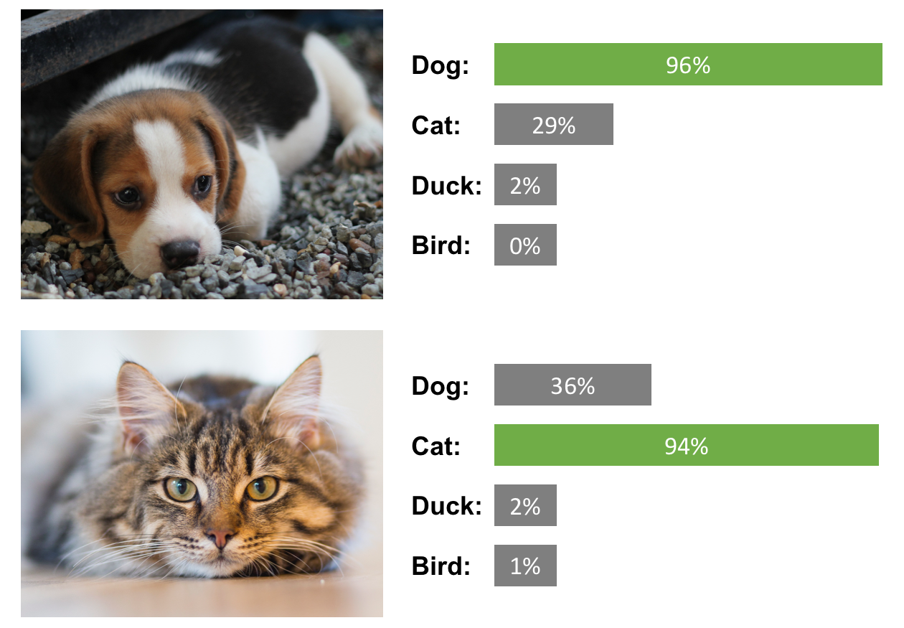
Results :

